Slide 1


Data structures: numbers and strings
Numerical data types
Strings data type
String operations
String methods
Formatting strings
Dr. Tateosian

Slide 2
Built-in data types
numbers
int x = 5
float x = 5.0
complex x = 3+4j
sequences
string x = "Ken"
tuple x = ( 8, "sky", blue )
list x = [ name, "rule", 2]
set types
set x = {"OK", "PA", "NC", "MD"}
mappings
dictionary x = { 13 : "Joe", 58 : "Ida"}
others (Booleans, functions, modules, and classes)

Slide 3
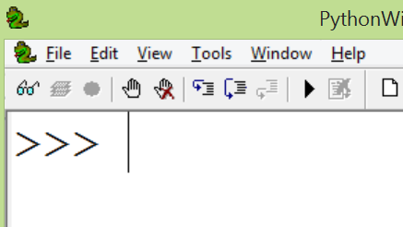
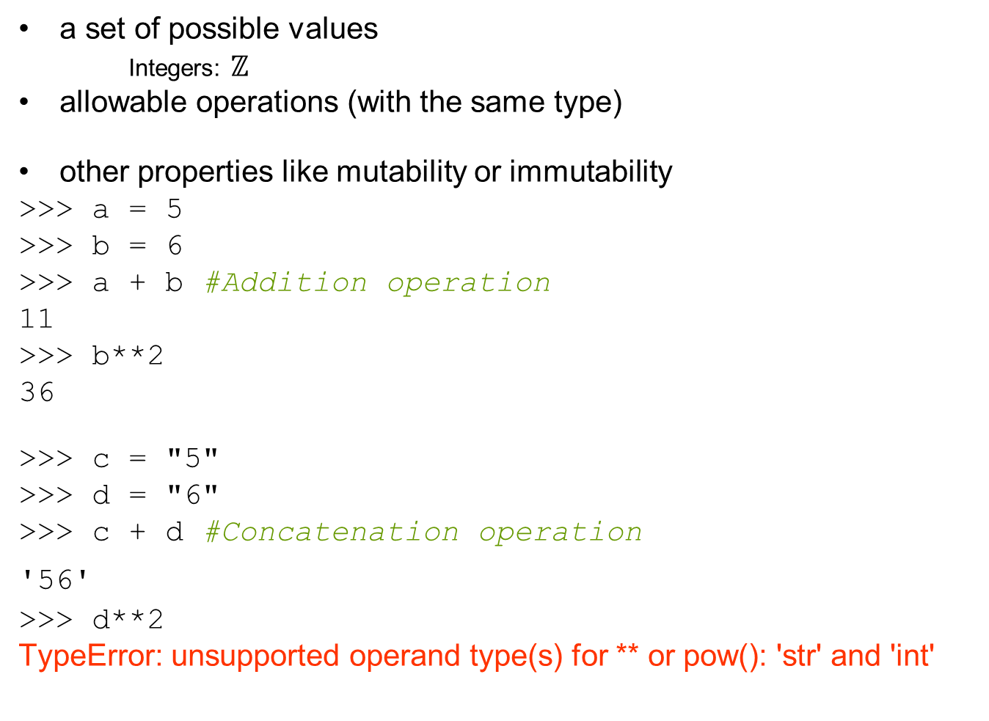
Each data type has…
a set of possible values
Integers: $ℤ$
allowable operations (with the same type)
other properties like mutability or immutability
>>> a = 5
>>> b = 6
>>> a + b #Addition operation
11
>>> b**2
36
>>> c = "5"
>>> d = "6"
>>> c + d #Concatenation operation
'56'
>>> d**2
TypeError: unsupported operand type(s) for ** or pow(): 'str' and 'int'

Slide 5


Slide 6
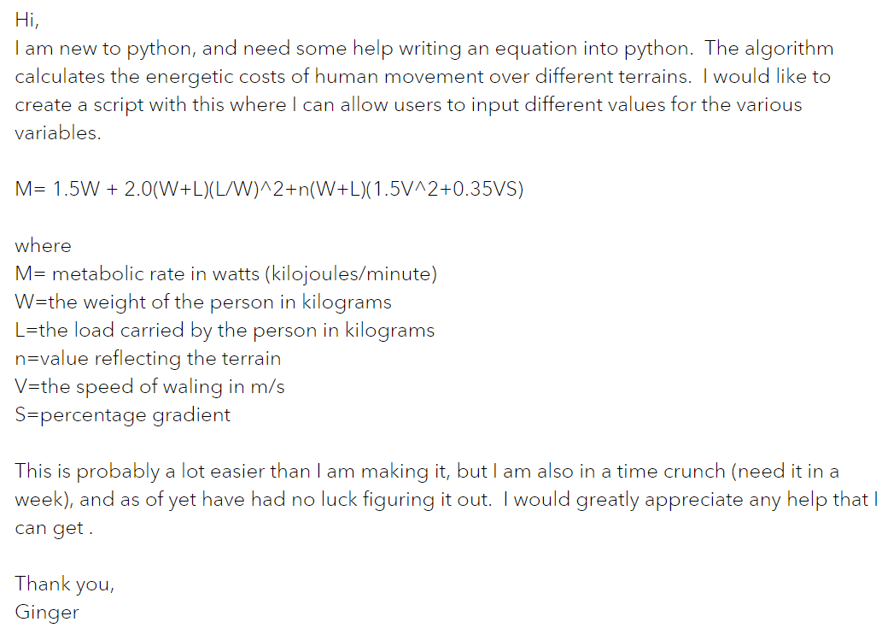
Calculating pedestrian energy costs
Notes:
https://community.esri.com/t5/python-questions/writing-an-equation-in-python/m-p/696388
Hi, I am new to python, and need some help writing an equation into python. The algorithm calculates the energetic costs of human movement over different terrains. I would like to create a script with this where I can allow users to input different values for the various variables. M= 1.5W + 2.0(W+L)(L/W)^2+n(W+L)(1.5V^2+0.35VS) where M= metabolic rate in watts (kilojoules/minute) W=the weight of the person in kilograms L=the load carried by the person in kilograms n=value reflecting the terrain V=the speed of waling in m/s S=percentage gradient This is probably a lot easier than I am making it, but I am also in a time crunch (need it in a week), and as of yet have had no luck figuring it out. I would greatly appreciate any help that I can get . Thank you, Ginger

Slide 7
Numeric data types
Numerical data Examples Python Type .
integers 5 -53336 0 int
floating points 5.002 -0.4 0.0 float
complex 5j 3 - 6j 0j complex
Notes:
\
-----------------------------------------------------------
DEMO6: NUMBERS
**************
>>> iNum = 7
>>> type(iNum)
<type 'int'>
>>> fNum = 7.0
>>> type(fNum)
<type 'float'>
>>> iNum == fNum
1
>>> fNum = 7.000001
>>> iNum == fNum
0
>>> fNum < iNum
0
>>> fNum > iNum
1
>>> int(fNum) == iNum
1
>>> float(iNum)
7.0
>>> float(iNum) == fNum
0
>>> fNum / 2
3.5000005000000001
>>> iNum / 2
3
>>> iNum / 2.
3.5
>>> divmod(iNum, 2)
(3, 1)
>>> round(fNum / 2) # rounds to the nearest int
4.0
>>> # if you always want to round down:
>>> from math import floor
>>> floor(40.9)
40.0
>>> # the same can be done with:
>>> int(40.9)
40
>>> 3**2
9
>>> 4**0.5
2.0
>>> 1 + 2
3
>>> 1 + 2 +
SyntaxError: invalid syntax
>>> 1 + 2 + \
3
6
-------------------------------------------------------
>>> # other goodies
>>> 1/2
0
>>> # int / int -> int
>>> # and rounds down
>>> # to make it more "natural":
>>> from __future__ import division
>>> 1/2
0.5
>>> # to get int / int -> int:
>>> 1//2
0
>>> # also with '//' we get float/float -> int:
>>> 1.0//2.0
0.0
>>> 0xA
10
>>> # with zero x leading indicates hexadecimals
>>> # Python handles large numbers
>>> 111111111111111111111
111111111111111111111L

Slide 8
Don't use commas in numbers
Numerical data Examples Python Type .
integers 5 -53336 0 int
floating points 5.002 -0.4 0.0 float
complex 5j 3 - 6j 0j complex
-53,336 not allowed

Slide 9
Mathematical operations
7 + 2
operator
Operation Operator Example
Addition + 7 + 2 = 9
Subtraction - 7 - 2 = 5
Multiplication * 7 * 2 = 14
Division / 7 / 2 = 3.5
Exponentiation ** 7**2 = 49
Modulus division % 7 % 2 = 1
Floor division // 7 // 3 = 2
Notes:
Floor division finds the quotient when the first operand is divided by the second

Slide 10
Dynamic typing for numbers
If the real number value has a decimal, the variable’s type is float.
>>> a = 7
>>> type(a)
<type 'int'>
>>> b = 7.0
>>> type(b)
<type 'float'>
>>> c = 7.0 + 3j
>>> type(c)
<class 'complex'>

Slide 11
How to write the equation in Python
M=metabolic rate in watts (kilojoules/minute) W=the weight of the person in kilograms L=the load carried by the person in kilograms n=value reflecting the terrain V=walking speed in m/s S=percentage gradient
M= 1.5W + 2.0(W+L)(L/W)^2+n(W+L)(1.5V^2+0.35VS)
In Python, what needs to change?
Notes:
In Python, what needs to be changed in this equation?

Slide 13
What can strings do?
specify file names
distance units
GIS tool parameters
workspaces
and field names
Set table values
Perform mapping
Read csv data
Get user arguments
print statements
and much more!
# describe_fc.py # Purpose: Print information about each feature class in a workspace. # Usage: Workspace # Example input: C:/gispy/data/ch02 # Output: A list of basic information about each feature class. # Author: Lou Lou Who 7/20/2055 import arcpy import sys # GET the input workspace from the user. arcpy.env.workspace = sys.argv[1] # GET a list of the feature classes in the workspace. fcs = arcpy.ListFeatureClasses() # PRINT basic information about each feature class in the folder. print(f"Feature classes in folder {arcpy.env.workspace}") for fc in fcs: desc = arcpy.Describe(fc) print(f"Name: {fc}") print(f"Data type: {desc.dataType}") print(f"Data class: {desc.dataSetType}") print(f"Type: {desc.featureType}") print(f"Shape type: {desc.shapeType}") print(f"Has M: {desc.hasM}") print(f"Has Z: {desc.hasZ}") print() print("Feature class list complete.")
Notes:
In Python, Strings are just sequences of characters. Why do we need them? What can strings do for you? In this script, strings are being used to print information about the GIS data in a workspace. They're also being used to specify the workspace. And they are being used to store the names of the data in the workspace. Strings are versatile and used all over the place in Python. You can use them to specify...

Slide 15

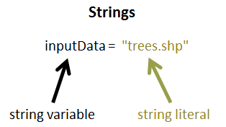
Strings
string: A data type for storing sequences of characters
string literal: A sequence of characters surrounded by quotations marks
string variable: A variable with a string literal value
The difference between these two terms is important, but both of these items are sometimes referred to simply as 'strings'.

Slide 16
String variable vs. string literal
output = "C:/data/clipped.shp"
Printing a string variable prints the value.
Printing a string literal prints that string literally.
Once you set your string variable, don’t use quotes around that name.
Use the variable name without quotation marks to reference the value.
>>> print(output)
C:/data/clipped.shp
>>> print("output")
output

Slide 17
Creating string literals
>>> 'I am a string'
'I am a string'
>>> "so am I"
'so am I'
>>> "Do not do this'
SyntaxError
>>> 'Don't do this either'
SyntaxError
>>> "Do this. I'd some eggs"
"Do this. I'd some eggs"
>>> "123 like *me* &#%"
'123 like *me* &#%'
>>> letters = 'a b c
SyntaxError
alphabet = """a b c
d e f"""
>>> print(alphabet)
a b c
d e f
Can use single, double, or triple quotation marks.
Opening and closing quotes match.
Embedded quotation marks must be different from outer ones.
Strings can contain numbers and special characters.
Start and end quotes must be on the same line, except if triple quotes or a line continuation character is used.

Slide 18

Backslash character in strings
line continuation
escape sequences
file paths
>>> print("C:\national_data")
Escape sequence examples
\b backspace
\n new line
\t tab
\\ \

Slide 19
Backslash character in strings
line continuation
escape sequences
file paths
>>> print("C:\national_data")
Escape sequence examples
\b backspace
\n new line
\t tab
\\ \

Slide 20
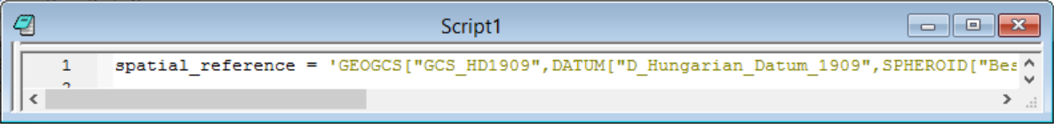

Line continuation character (\)
>>> spatial_reference = 'GEOGCS["GCS_HD1909",DATUM["D_Hungarian_Datum_1909",
SPHEROID["Bessel_1841",6377397.155,299.1528128]],
PRIMEM["Greenwich",0.0],UNIT["Degree",0.0174532925199433]]'
To avoid scrolling, use line width < 90 characters (roughly)
>>> # Find the number of characters in the spatial_reference string
>>> len(spatial_reference) 158
A string must
start and end a single line OR
use a line continuation character ( \) at the end of a line of code OR
use triple quotes
syntax error
(script won’t run)
Line
continuation
characters

Slide 21
Line continuation versus triple quote
A backslash embedded in a string at the end of a line, allows a string to be written on more than one line.
Triple quotes allows a string to be written on more than one line.
Line continuation | Triple quotes
lettersLC = 'a b c \ d e f \ g h i' >>> print(lettersLC) a b c d e f g h i | lettersTQ = '''a b c d e f g h i''' >>> print(lettersTQ) a b c d e f g h i
Preserves single line spacing | Printed on separate lines.

Slide 22
Backslash character in strings
line continuation
escape sequences
file paths
>>> print("C:\national_data")
Escape sequence examples
\b backspace
\n new line
\t tab
\\ \

Slide 23
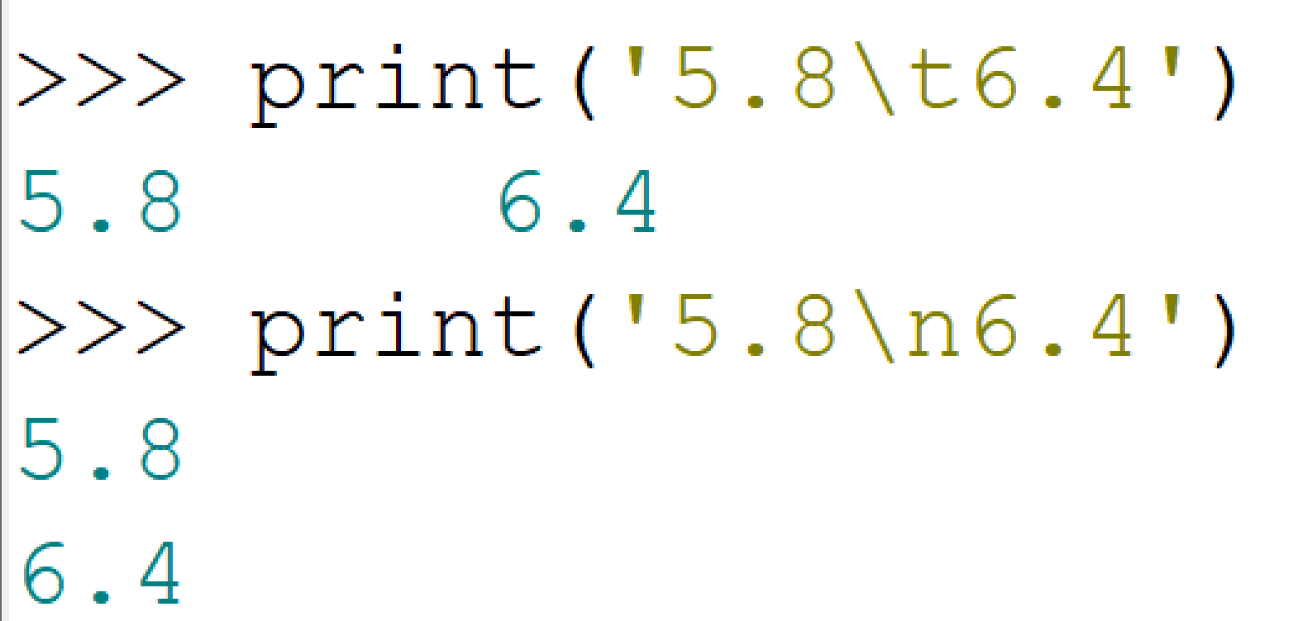
Escape sequences for formatting
In Python strings, backslash is a special character.
When followed immediately by certain characters, it signifies an alternative interpretation.
Useful for formatting printed data
Escape sequence examples
\b backspace
\n new line
\t tab
\\ \
Notes:
>>> print("5.8\t6.4")
5.8 6.4
>>> print("5.8\n6.4")
5.8
6.4

Slide 24
Backslash character in strings
line continuation
escape sequences
file paths
>>> print("C:\national_data")
Escape sequence examples
\b backspace
\n new line
\t tab
\\ \

Slide 25
File paths
>>> print("C:\national_data")
C:
ational_data
# Use / or \\ or r
>>> print("C:/national_data") # preferred
C:/national_data
>>> print("C:\\national_data")
C:\national_data
>>> print(r"C:\national_data") # raw string
C:\national_data
new line escape sequence

Slide 26
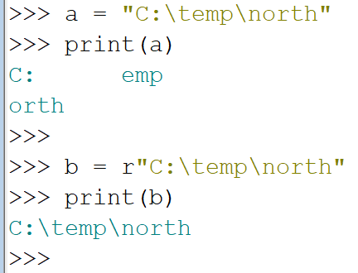
Raw strings
What does that little r before a string literal do?
raw string: r"C:\temp"
not a raw string: "C:\temp"
In a raw string, A backslash (\) is interpreted literally, as a backslash. There are no "escape sequences" to represent newlines, tabs, etc.
Notes:
16:05

Slide 27
Common string operations
indexing (zero-based) | >>> x = "abcde" >>> x[3] 'd'
concatenation (from Latin com: together + catena: chain) | >>> y = "soup" >>> x + y 'abcdesoup'
slicing | >>> x[1:4] 'bcd'
Finding length | >>> len(x) 5
Checking for membership in | >>> "abc" in y False

Slide 28
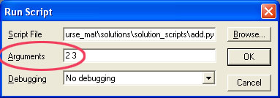
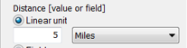
Casting (type conversion)
Recall add.py
print(int(sys.argv[1]) + int(sys.argv[2]))
5
Casting
converts a variable value from one type to another (if possible)
Built-in functions: int(x), float(x), str(x), list(x)…
Measurement units for geospatial tools like buffering, near feature, etc.
>>> num = 3.8
>>> unit = "km"
>>> buff_dist = num + unit
TypeError: unsupported operand type(s) for +: 'float' and 'str'
>>> buff_dist = str(num) + " " + unit
'3.8 km'
String to integer | Number to string | String to float | When it’s not possible?
>>> val = "6" >>> int(val) 6 | >>> num = 3.8 >>> str(num) '3.8' | >>> val = "-6.25" >>> float(val) -6.25 | >>> val = "3.8" >>> int(val) ValueError: invalid literal for int() with base 10: '3.8'
0.25
Recall ‘Simple buffer’ example:
arcpy.Buffer_analysis('park.shp', 'C:/gispy/scratch/parkBuffer.shp', '0.25 miles', 'OUTSIDE_ONLY', 'ROUND', 'ALL')
# Purpose: Buffer a park varying buffer distances from 1 to 5 miles.
inName = 'park.shp'
for num in range(1, 6):
# Set the buffer distance based on num ('1 miles', '2 miles', ...).
distance = str(num) + ' ' + 'miles'
# Set the output name based on num ('buffer1.shp', 'buffer2.shp', ...)
outName = outDir + 'buffer{0}.shp'.format(num)
arcpy.Buffer_analysis(inName, outName, distance)
print(f'{ourDir}{outName} created.')

Slide 30
Cost of walking example
"I am new to python, and need some help writing an equation into python..."
M=metabolic rate in watts (kilojoules/minute) W=the weight of the person in kilograms L=the load carried by the person in kilograms n=value reflecting the terrain V=walking speed in m/s S=percentage gradient
M = 1.5W + 2.0(W+L)(L/W)^2+n(W+L)(1.5V^2+0.35VS)
m = 1.5 * W + 2 * (W + L) * (L / W)**2 + n * (W + L) * (1.5 * V**2 + 0.35 * V * S)

Slide 31
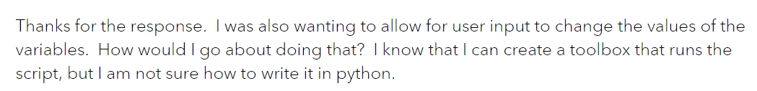
Thanks, but
"I am new to python, and need some help writing an equation into python..."
M=metabolic rate in watts (kilojoules/minute) W=the weight of the person in kilograms L=the load carried by the person in kilograms n=value reflecting the terrain V=walking speed in m/s S=percentage gradient
M = 1.5W + 2.0(W+L)(L/W)^2+n(W+L)(1.5V^2+0.35VS)
m = 1.5 * W + 2 * (W + L) * (L / W)**2 + n * (W + L) * (1.5 * V**2 + 0.35 * V * S)
"
"

Slide 32
Allow the user to input values solution 1
M=metabolic rate in watts (kilojoules/minute) W=the weight of the person in kilograms L=the load carried by the person in kilograms n=value reflecting the terrain V=walking speed in m/s S=percentage gradient
M = 1.5W + 2.0(W+L)(L/W)^2+n(W+L)(1.5V^2+0.35VS)
# Usage: weight_in_kg load_in_kg terrain_roughness walking_speed_in_m/s gradient
# Example input: 68 4.5 2 1.4 5
import sys
W = sys.argv[1]
L = sys.argv[2]
n = sys.argv[3]
V = sys.argv[4]
S = sys.argv[5]
m = 1.5 * W + 2 * (W + L) * (L / W)**2 + n * (W + L) * (1.5 * V**2 + 0.35 * V * S)
print(f"Metabolic rate = {m} watts")
?

Slide 33
Allow the user to input values solution 2
M=metabolic rate in watts (kilojoules/minute) W=the weight of the person in kilograms L=the load carried by the person in kilograms n=value reflecting the terrain V=walking speed in m/s S=percentage gradient
M = 1.5W + 2.0(W+L)(L/W)^2+n(W+L)(1.5V^2+0.35VS)
# Usage: weight_in_kg load_in_kg terrain_roughness walking_speed_in_m/s gradient
# Example input: 68 4.5 2 1.4 5
import sys
W = int(sys.argv[1])
L = int(sys.argv[2])
n = int(sys.argv[3])
V = int(sys.argv[4])
S = int(sys.argv[5])
m = 1.5 * W + 2 * (W + L) * (L / W)**2 + n * (W + L) * (1.5 * V**2 + 0.35 * V * S)
print(f"Metabolic rate = {m} watts")
?

Slide 34
Allow the user to input values solution
M=metabolic rate in watts (kilojoules/minute) W=the weight of the person in kilograms L=the load carried by the person in kilograms n=value reflecting the terrain V=walking speed in m/s S=percentage gradient
M = 1.5W + 2.0(W+L)(L/W)^2+n(W+L)(1.5V^2+0.35VS)
# Usage: weight_in_kg load_in_kg terrain_roughness walking_speed_in_m/s gradient
# Example input: 68 4.5 2 1.4 5
import sys
W = float(sys.argv[1])
L = float(sys.argv[2])
n = float(sys.argv[3])
V = float(sys.argv[4])
S = float(sys.argv[5])
m = 1.5 * W + 2 * (W + L) * (L / W)**2 + n * (W + L) * (1.5 * V**2 + 0.35 * V * S)
print(f"Metabolic rate = {m} watts")

Slide 36
String methods
Functions associated with strings
Examples: capitalize, upper, lower, count, find, replace, endswith, join, format, startswith,…
String method documentation
>>> bird = "Parrot"
>>> lowerBird = bird.lower( )
>>> lowerBird
'parrot'
>>> food = bird.replace("P","C")
>>> food
'Carrot'
>>> state = "Mississippi"
>>> state.count('s')
4
object.method(argument 1, argument 2, …)
no arguments
object method
two arguments
one argument
Notes:
String methods are special functions associated only with strings. You can only call the capitalize function on a string type variable. But all the function vocabulary we already discussed still apply:
You call a string method
bird.lower()
Most string methods return a value.
bird.lower() returns 'parrot'
You pass arguments into the methods.
'P' and 'C' are arguments for the
replace method example on this slide.

Slide 37
Kinds of string methods
object.method(argument 1, argument 2, …)
bird = "Parrot LIKES you"
Casing
bird.capitalize() -> Parrot likes you
bird.lower() -> parrot likes you
bird.title() -> Parrot Likes You
bird.swapcase() -> pARROT likes YOU
bird.upper() -> PARROT LIKES YOU
Is it one of these?
bird.isalnum() -> True "rr&#ha@/gg".isalnum()-> False
bird.isalpha() -> True "abc1".isalpha() -> False
"2.34".isdigit() -> False "234".isdigit() -> True
bird.islower() -> False "but i am".islower() -> True
bird.isspace() -> False "\n\t\t \n".isspace() -> True
bird.istitle() -> False "But I Am".istitle() -> True
bird.isupper() -> False "BUT I AM".isupper()-> True
Position/presence of substrings
bird.find("o") -> 4
bird.find("q") -> -1
bird.index("ot") -> 4
bird.index("q") -> ValueError: substring not found
bird.startswith("ou") -> False
bird.endsswith("ou") -> True

Slide 38

kinds of string methods cont’d
Formatting
"{1}-bird is {0} feet tall".format(2, 'Polly') -> Polly-bird is 2 feet tall
"abc".rjust(6) -> ' abc'
"123".zfill(6) -> '000123'
Stripping
" \t abc \n".strip() -> 'abc'
" \t abc \n".lstrip() -> 'abc \n'
" \t abc \n".rstrip() -> ' \t abc'
Encoding
myStr = "US, National Immunization SurveyQ1/2012-Q4\u2020"
myStr.encode('ascii', 'ignore') -> 'US, National Immunization SurveyQ1/2012-Q4'
Replacing
bird = "Parrot LIKES you"
bird.replace("LIKES", "adores") -> 'Parrot adores you'
Split/joining
"11:50:22.040000".split(":") -> ['11', '50', '22.040000'] "One potato, two potato, three potato four".split("potato") -> ['One ', ', two ', ', three ', ' four'] "Mississippi".split("I") -> ['M', 'ss', 'ss', 'pp', ''] "AC".join(["M", "ss", "ss", "pp", ""]) -> 'MACssACssACppAC'
";".join(["Raleigh", "NC", "27695"]) -> 'Raleigh;NC;27695'
dagger symbol
How could you use the
replace method to remove
the spaces?

Slide 40
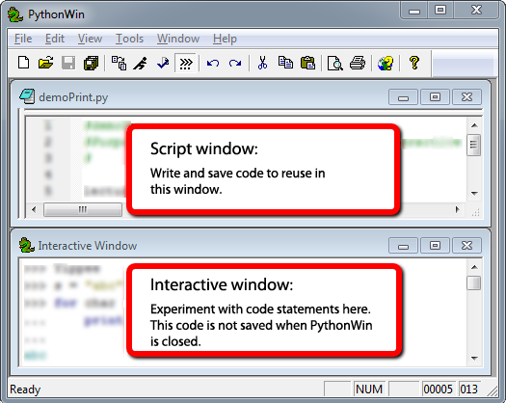
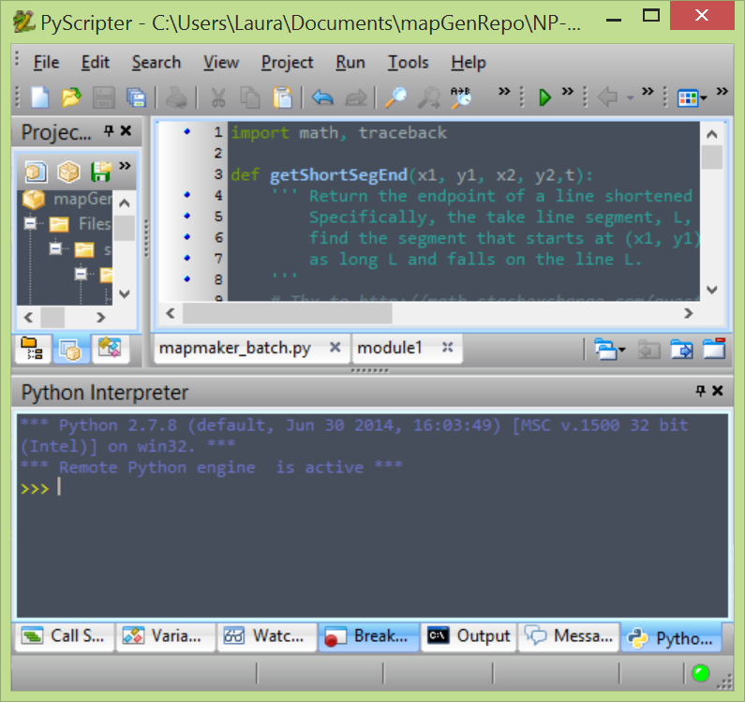
Script vs. Interactive windows
Script Window
Write code.
Save code.
Run code. (Code is not evaluated as soon as you click ‘Enter’)
Close PythonWin and work is saved.
The interactive environment:
User types a line of code in the interactive window, for example, print("Hello").
The user presses 'Enter' to indicate that the line of code is complete.
The single line of code is run.
Close PythonWin and all work is lost.
"Python Interpreter" window is interactive window in PyScripter and other IDEs.

Slide 41
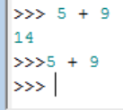
Tips for the interactive window
Interactive window command prompt: >>>
Must be a space between prompt and code
Hitting Return takes you to the right spot.
Don’t space or backspace before typing.
If a command doesn’t work, hit Return key (or Enter key), then retype it.
In the interactive window you can print variable value with or without ‘print’.
>>> print (inputFile)
trees.shp
>>> inputFile
'trees.shp'
IDE session --when you open the IDE, a session starts; when you close the IDE the current session ends. If you open it again, a new ‘session’ starts.
IDEs stores current session command history.
To access previous commands, in PythonWin: Ctrl+ uparrow in PyScripter: uparrow
Heed Window Focus (the active window)!
Shift focus to the script window before saving a script (else you might unintentionally save interactive window contents).
A variable assigned a value during the current session keeps that value until it is assigned another value (demo: x = 5)
Within a script, this will not print anything.
Notes:
>>> print FID
>>> FID
>>> 145
>>> print fid

Slide 42
Exercise: Explore string operations
Try each statement in the interactive window & answer the questions.
x = "GIS"
x[0]
x[3]
"s" in x
len(x)
y = "rules"
x = x + y
len(x)
"s" in x
x[0:2]
x[:2]
x[2]
x[1:3]
x[-4:0]
x[:-4]
x
x[3]
print x,y
print x+y
numStr = "742"
numStr.zfill(8)
1. Why does x[3] give an error the 1st time but not the 2nd time?
2. What does Python keyword in do? Does case matter?
3. How could you change the statement x = x+y to print "GIS rules"?
4. What’s the difference between x[:2], x[0:2], and x[2]?
5. What does x[:-4]do?
6. Does x.lower()change the value of x? If so, how?
7. What's the difference between the output of print(x,y) and print(x+y)?

Slide 43
‘Explore string operations’ Q & A
x = "GIS"
x[0]
x[3]
"s" in x
len(x)
y = "rules"
x = x + y
len(x)
"s" in x
x[0:2]
x[:2]
x[2]
x[:-4]
x[3]
x
print x,y
print x+y
numStr = "742"
numStr.zfill(8)
1. Why does x[3] give an error the 1st time but not the 2nd time?
There’s no 4th character the first time (but there is the second).
2. What does Python keyword in do? Does case matter?
Checks for membership in. Yes, it’s case sensitive.
3. How could you change the statement x = x+y to print "GIS rules"?
x = x + " " + y
4. What’s the difference between x[:2], x[0:2], and x[2]?
x[:2] slices (returns the first 2 characters). x[0:2] does the same. x[2] indexes (returns the 3rd character).
5. What does x[:-4] do?
Returns all but the last 4 characters. If there aren’t 4 character, it returns an empty string.
6. Does x.lower()change the value of x? If so, how?
No! It returns an all lowercase version of x, but x itself is unchanged.
7. What's the difference between the output of print(x,y) and print(x+y)?
The comma inserts a space.

Slide 44
‘Explore string ops’ take home messages
Indexing is zero-based.
Indexing throws an ‘IndexError’ exception if the index is greater than n-1, for n = length_of_string.
Indexing & slicing look alike; but slicing uses a colon and (optionally) both start & end indices.
Spaces must be inserted explicitly in concatenation.
String methods do NOT alter the string itself. Instead, they ‘return’ the value.
If you are not sure what a method does, try an example in the interactive window and/or look at the string method documentation.

Slide 45
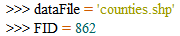

Approaches to creating strings with variables
Commas?
Concatenation?
String format method
Formatted string literals (f-strings)
>>> message = "The first FID in", dataFile , "is", FID, "!">>> message
('The first FID in', 'counties.shp', 'is', 862, '!')
>>> message = "The first FID in" + dataFile + "is" + str(FID) + "!"
>>> message
'The first FID incounties.shpis862'
>>> message = "The first FID in {0} is {1}!".format(dataFile, FID)
>>> message
'The first FID in counties.shp is 862!'
>>> message = f"The first FID in {dataFile} is {FID}!"
>>> message
'The first FID in counties.shp is 862!'

Slide 46
String ‘format’ method
Combine data types in a string using
casting and concatenation OR string formatting
Curly braces with numbers inside are place holders in a string literal.
Place things to insert into the string comma separated inside the parentheses
>>> x = 5.3398
>>> unit = 'miles'
>>> inFile = 'trees.shp'
>>> print('File {0} was buffered with a {1:.2f} {2} buffer.'.format(inFile, x, unit))
File trees.shp was buffered with a 5.34 miles buffer.
>>> a = [1,2,3]
>>> b = 'GIS'
>>> myStr = '{0} is as easy as {1}'.format(b, a)
>>> myStr
'GIS is as easy as [1, 2, 3]'
num = 3.8
unit = "km"
buff_dist = str(num) + " " + unit
num = 3.8
unit = "km"
buff_dist = "{0} {1}".format(num,unit)
{1:.2f} returns two decimal places of a float

Slide 47
Formatted string literals (f-string)
Combine data types in a string using
casting and concatenation OR f-string
Curly braces with numbers inside are place holders in a string literal.
Place things to insert into the string comma separated inside the parentheses
>>> x = 5.3398
>>> unit = "miles"
>>> inFile = "trees.shp"
>>> print(f"File {inFile} was buffered with a {x:.2f} {unit} buffer.")
File trees.shp was buffered with a 5.34 miles buffer.
>>> a = [1,2,3]
>>> b = "GIS"
>>> myStr = f"{b} is as easy as {a}"
>>> myStr
'GIS is as easy as [1, 2, 3]'
num = 3.8
unit = "km"
buff_dist = str(num) + " " + unit
num = 3.8
unit = "km"
buff_dist = f"{num} {unit}"
{1:.2f} returns two decimal places of a float
Notes:
DEMO7: STRINGS
*********************
>>> first_name = "Laura"
>>> last_name = "Tateosian"
>>> print(first_name+ " " + last_name)
Laura Tateosian
>>> mycat = "Jack"
>>> print(mycat[0])
Jack
>>> print(mycat[4])
Traceback (most recent call last): File "<interactive input>", line 1, in ?
IndexError: string index out of range
-----------------------------------------------------------
>>> # you can directly index any sequence which is returned by a function
>>> firstInitial = raw_input("Enter your name ")[0]
Enter your name Laura
>>> firstInitial
‘L'
print("""These triple quotations will preserve the
line breaks""")
print ("otherwise you have to
hardcode line breaks")
print("You can do that with the \n carriage return special sequence")
>>> w1 = ‘dough’
>>> w2 = "nut"
>>> breakfast = w1+ w2
>>> print( breakfast)
doughnut
print "I wish I had a " + breakfast + "I want a " + breakfast
>>> w1 = "V"
>>> w2 = 8 #not a string
>>> breakfast = w1+ w2
>>> print (breakfast)
Typeerror
>>> myst = "candycane"
>>> myst[0:5]
'candy‘
>>> lastname = "Dangermond"
>>> mycat = mycat + lastname
>>> print(mycat)
JackDangermond
#filename as string
------------------------------------------------------------
#Three ways that work:
>>>mydir = "c:/nr536"
>>>mydir = "c:\\nr536"
>>>mydir = r"c:\nr536" #raw input mode does not convert \n to newline
#One that won’t work:
mydir = "c:\nr536"
>>> mydir ="c:\nr536"
>>> print (mydir)
c:
r536
-----------------------------------------------------------
>>> # string methods
>>> shapefile = "roads.shp"
>>> len(shapefile)
9
>>> from string import *
>>> capitalize(shapefile)
'Roads.shp'
>>> uppered = upper(shapefile)
>>> uppered
'ROADS.SHP'
>>> lowered = lower(uppered)
>>> lowered
'roads.shp'
>>> count(shapefile, "s")
2
>>> "shp" in shapefile
True
>>> find(shapefile, "shp")
6
>>> replace(shapefile, "roads", "rivers")
'rivers.shp'
>>> index(shapefile, ".")
5
>>> strg = "This is string"
>>> strg.endswith("ing")
True
>>> strg.endswith("ing", -2)
False
>>> space = " "
>>> space.isspace()
True
>>> not_space = "aaa"
>>> not_space.isspace()
False
-----------------------------------------------------------
#String Formatting
>>> print ("%s is fabulous in %d and the temperature is %f degrees!" %("Raleigh, NC", 2007, 71.54))
Raleigh, NC is fabulous in 2007 and the temperature is 71.540000 degrees!
>>>print("%s is fabulous in %d and the temperature is %.2f degrees!" %("Raleigh, NC", 2007, 71.54))
Raleigh, NC is fabulous in 2007 and the temperature is 71.54 degrees!

Slide 48
Summing up
Topics discussed
Data types: integers, float, strings
Integer division
String literal vs. string variable
String & list indexing, slicing, concatenation, len, ‘in’ keyword
String line continuation, escape sequences, raw strings
String format method and f-strings
Up next
Lists and tuples
Appendix topics
Commas vs concatenation
Old school style formatting
Escaping quotation marks

Slide 49
Appendix

Slide 50
Appendix: Commas versus concatenation
>>> fcName = "park"
>>> count = 1
>>> print("Clip file:", fcName, count, ".shp")
Clip file: park 1 .shp
>>> print("Clip file:" + fcName + count, ".shp")
Typeerror
>>> print("Clip file:" + fcName + str(count) + ".shp")
Clip file:park1.shp
>>> print("Clip file:", fcName + str(count) + ".shp")
Clip file: park1.shp

Slide 51
Appendix: Old school string formatting
Mixing elements (heterogeneous content)
% - conversion specifier
"…%format…." % (what_to_format)
String templates (Template)
>>> x = 5
>>> unit = "miles"
>>> inFile = "trees.shp"
>>> print("File %s was buffered with a %d %s buffer." % ( inFile, x, unit))
File trees.shp was buffered with a 5 miles buffer.
%d integer
%s string
%f float
%.2f two digits float
Notes:
DEMO7: STRINGS
*********************
>>> first_name = "Jack"
>>> last_name = "BeQuick"
>>> print first_name,last_name
Jack BeQuick
>>> mycat = "Jack"
>>> print (mycat[0])
J
>>> print mycat[4]
Traceback (most recent call last): File "<interactive input>", line 1, in ?
IndexError: string index out of range
-----------------------------------------------------------
>>> # you can directly index any sequence which is returned by a function
>>> firstInitial = raw_input("Enter your name ")[0]
Enter your name Jack
>>> firstInitial
‘J’
print """These triple quotations will preserve the
line breaks"""
print "otherwise you have to
hardcode line breaks"
print "You can do that with the \n carriage return special sequence"
>>> w1 = ‘dough’
>>> w2 = "nut"
>>> breakfast = w1+ w2
>>> print breakfast
doughnut
print "I wish I had a " + breakfast + "I want a " + breakfast
>>> w1 = "V"
>>> w2 = 8 #not a string
>>> breakfast = w1+ w2
>>> print breakfast
Typeerror
>>> myst = "candycane"
>>> myst[0:5]
'candy‘
>>> lastname = "Dangermond"
>>> mycat = mycat + lastname
>>> print mycatJackDangermond
#filename as string
------------------------------------------------------------
#Three ways that work:
>>>mydir = "c:/nr536"
>>>mydir = "c:\\nr536"
>>>mydir = r"c:\nr536" #raw input mode does not convert \n to newline
#One that won’t work:
mydir = "c:\nr536"
>>> mydir ="c:\nr536"
>>> print mydir
c:
r536
-----------------------------------------------------------
>>> # string methods
>>> shapefile = "roads.shp"
>>> len(shapefile)
9
>>> from string import *
>>> capitalize(shapefile)
'Roads.shp'
>>> uppered = upper(shapefile)
>>> uppered
'ROADS.SHP'
>>> lowered = lower(uppered)
>>> lowered
'roads.shp'
>>> count(shapefile, "s")
2
>>> "shp" in shapefile
True
>>> find(shapefile, "shp")
6
>>> replace(shapefile, "roads", "rivers")
'rivers.shp'
>>> index(shapefile, ".")
5
>>> strg = "This is string"
>>> strg.endswith("ing")
True
>>> strg.endswith("ing", -2)
False
>>> space = " "
>>> space.isspace()
True
>>> not_space = "aaa"
>>> not_space.isspace()
False
-----------------------------------------------------------
#String Formatting
>>> print "%s is fabulous in %d and the temperature is %f degrees!" %("Raleigh, NC", 2007, 71.54)
Raleigh, NC is fabulous in 2007 and the temperature is 71.540000 degrees!
>>>print "%s is fabulous in %d and the temperature is %.2f degrees!" %("Raleigh, NC", 2007, 71.54)
Raleigh, NC is fabulous in 2007 and the temperature is 71.54 degrees!

Slide 52
Appendix: More old-school examples
"…%format…." % (what_to_format)
num_parsels = 500
my_polygon = "RTP"
sentence = "%d parcels intersect with %s" %(num_parsels,my_polygon)
print sentence
>>> 500 parcels intersect with RTP
print num_parsels, "parcels intersect with",my_polygon
>>> 500 parcels intersect with RTP
sentence = num_parsels, "parcels intersect with",my_polygon
print sentence
>>>(5, 'parcels intersect with', 'selected region')
%d integer
%s string

Slide 53
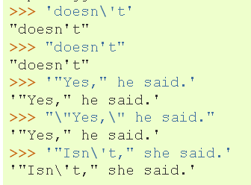
Appendix: Escaping the quotation marks
String ends where it finds the first matching quote.
>>> 'doesn't'
'doesn't'
^
Traceback ( File "<interactive input>", line 1 'doesn't'
SyntaxError: invalid syntax
Use \ or combination of ' and " to make a string which contains quotes.
Escape from the inside quotation mark with a backslash with an escape sequence \' or \"
>>> 'doesn\'t'
"doesn't"
How would you would fix this one?
>>> "He said, "I love GIS""
Notes:
Fix the last one as follows
>>> "He said, \"I love GIS\""

Slide 54
Appendix: Operations
int
>>> x = 1 # What type is x?
How can I make x a float?
x = 1.0 or x = float(x) #This casts x to a float
What is kind of statement is x = 1?
An assignment statement
What kind of statement is x == 1?
A conditional statement
x = y #What result does this yield?
If y is defined, it sets x equal to y. If not, it throws an exception.

Slide 55
Numeric data types
Tip Commas are not allowed in Python numbers
e.g., 1,000,000 is not valid
Numerical data types Examples .
integers ('int') 5 -53336 0
floating points ('float') 5.002 -0.4 0.0
complex ('complex') 5j 3 - 6j 0j
Mathematical operations
Operation Operator Example
Addition + 7 + 2 = 9 Subtraction - 7 - 2 = 5 Multiplication * 7 * 2 = 14 Division / 7 / 2 = 3 Exponentiation ** 7**2 = 49 Modulus division % 7 % 2 = 1
Dynamic typing
If the value has a decimal, the var’s type is float
float versus integer division
Caution: integer division truncates
# Example
>>> a = 7
>>> type(a)
<type 'int'>
>>> b = 7.0
>>> type(b)
<type 'float'>
>>> b / 2
3.5000005000000001
>>> a / 2
3
Notes:
-----------------------------------------------------------
DEMO6: NUMBERS
**************
>>> iNum = 7
>>> type(iNum)
<type 'int'>
>>> fNum = 7.0
>>> type(fNum)
<type 'float'>
>>> iNum == fNum
1
>>> fNum = 7.000001
>>> iNum == fNum
0
>>> fNum < iNum
0
>>> fNum > iNum
1
>>> int(fNum) == iNum
1
>>> float(iNum)
7.0
>>> float(iNum) == fNum
0
>>> fNum / 2
3.5000005000000001
>>> iNum / 2
3
>>> iNum / 2.
3.5
>>> divmod(iNum, 2)
(3, 1)
>>> round(fNum / 2) # rounds to the nearest int
4.0
>>> # if you always want to round down:
>>> from math import floor
>>> floor(40.9)
40.0
>>> # the same can be done with:
>>> int(40.9)
40
>>> 3**2
9
>>> 4**0.5
2.0
>>> 1 + 2
3
>>> 1 + 2 +
SyntaxError: invalid syntax
>>> 1 + 2 + \
3
6
-------------------------------------------------------
>>> # other goodies
>>> 1/2
0
>>> # int / int -> int
>>> # and rounds down
>>> # to make it more "natural":
>>> from __future__ import division
>>> 1/2
0.5
>>> # to get int / int -> int:
>>> 1//2
0
>>> # also with '//' we get float/float -> int:
>>> 1.0//2.0
0.0
>>> 0xA
10
>>> # with zero x leading indicates hexadecimals
>>> # Python handles large numbers
>>> 111111111111111111111
111111111111111111111L

Slide 56
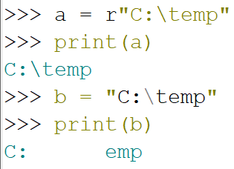
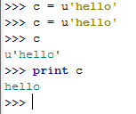
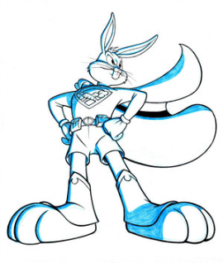
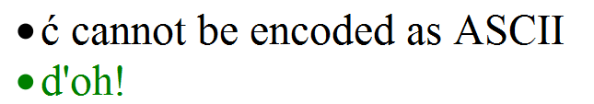
r or u before string literal
What does that little r mean?
a is a raw string literal
b is a string literal
In a raw string literal, -a backslash, \, is taken as meaning "just a backslash -there are no "escape sequences" to represent newlines, tabs, backspaces, form-feeds, and so on.
What does that little u mean?
c is a unicode string.
--In Python 2.* most strings are ASCII
--ASCII – created in 1963 as the American Standard Code for Information Interchange; each character is one byte; 128 possible characters.
--Unicode demystified: http://farmdev.com/talks/unicode/
Unicode to the rescue!
Notes:
16:05

